Slide 1

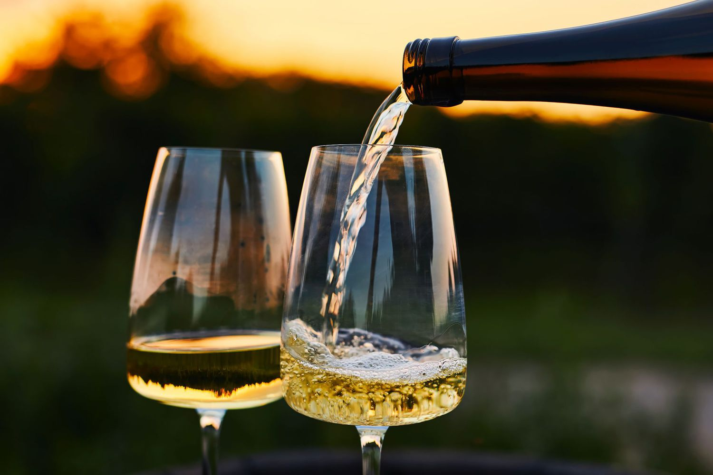
White Wine Quality
Data Analysis and Shiny App
Greta Bussmann (64557)
Teresa Pinto Coelho (64515)
for
Biostatistics Laboratory 2024/2025

Slide 2
Content
The introduction
01
PCA & Cluster Analysis
02
Shinny App
03

Slide 3
Why Wine?
Significance of Wine in Portugal:
  Key role in culture and history
  Portugal as a major wine producer – e.g. vinho verde an iconic, fresh, and light wine
Wine Consumption in Portugal:
  Highest per capita consumption globally: 52.5 liters per person (2022/2023)
  Comparison: Germany consumes 27.6 liters per person

Slide 4
The Dataset
Data Source
  ‘winequality-white.csv‘ from Cortez et al. (2009)
  (https://www.kaggle.com/datasets/piyushagni5/white-wine-quality)
  Focus: White wines of the Vinho Verde
Dataset Structure:
  4,898 entries, divided into 12 variables influencing wine quality
11 physicochemical characteristics | fixed acidity
 | volatile acidity
 | citric acid
 | residual sugar
 | Chlorides
 | free sulfur dioxide
 | total sulfur dioxide
 | Density
 | pH
 | Sulphates
 | Alcohol
1 ordinal characteristic | Quality score (1-10)

Slide 5
Analysis
Data-Driven Analysis:
  → Focus on chemical properties and their connection to wine quality
Goal:
  → Model winequality based on phyicochemical characteristics
Methods:
  Utilization of modern techniques like PCA (Principal Component Analysis) and clustering
  PCA: Dimensionality reduction to identify key variables; Highlight similarities and simplify interpretation
  K-means Cluster Analysis: Group wines based on similarities; Uncover potential patterns or relationships
  Development of a Shiny app for user-friendly data access and manipulation.

Slide 6
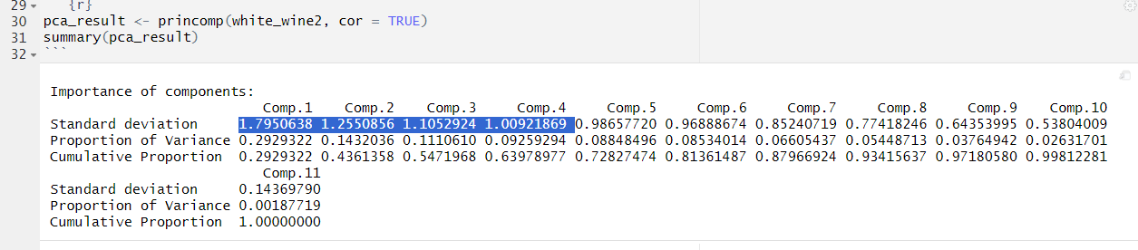
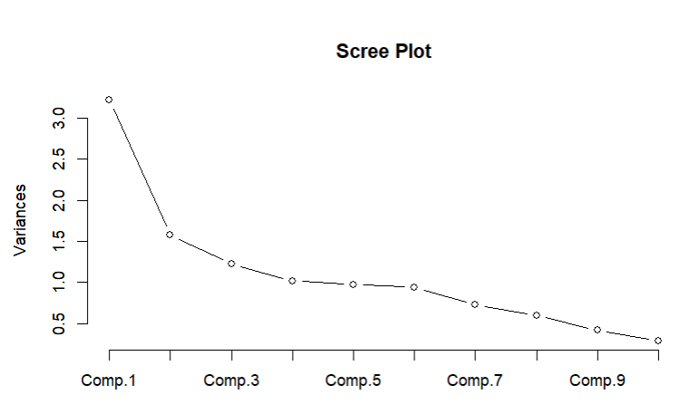
Principal Component Analysis

Slide 7
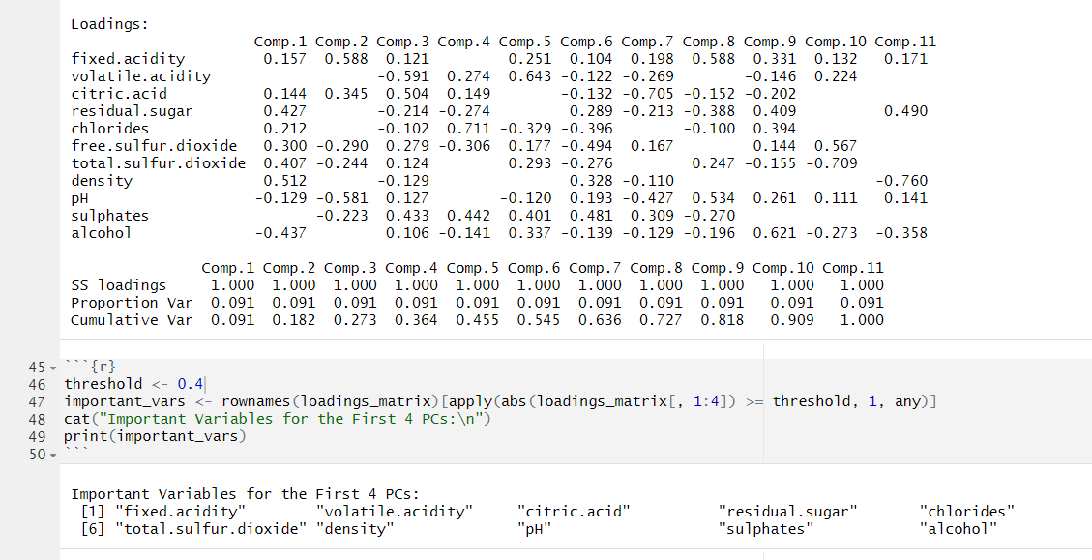
Principal Component Analysis

Slide 8
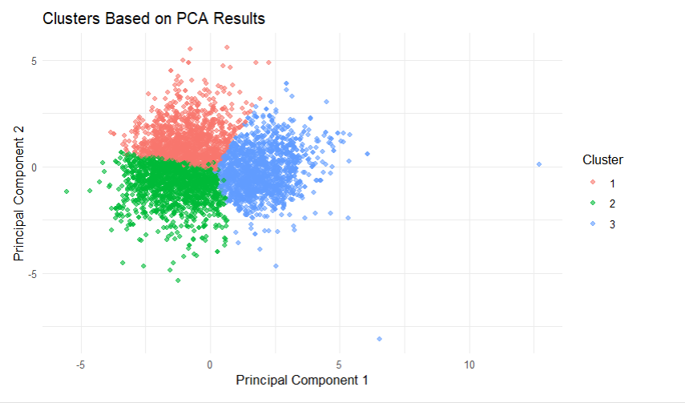
Cluster Analysis

Slide 9
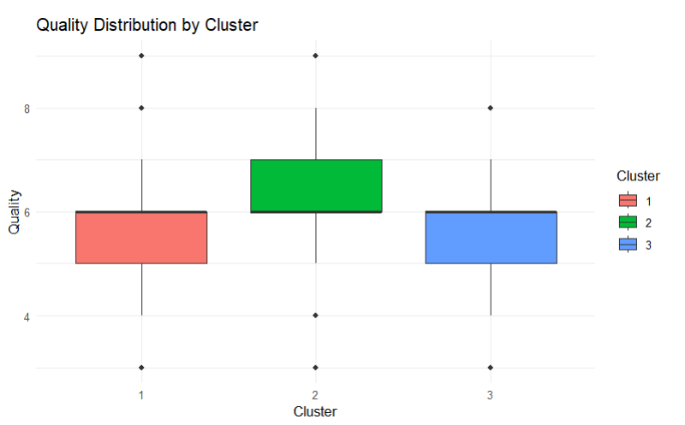
Quality Analysis

Slide 10
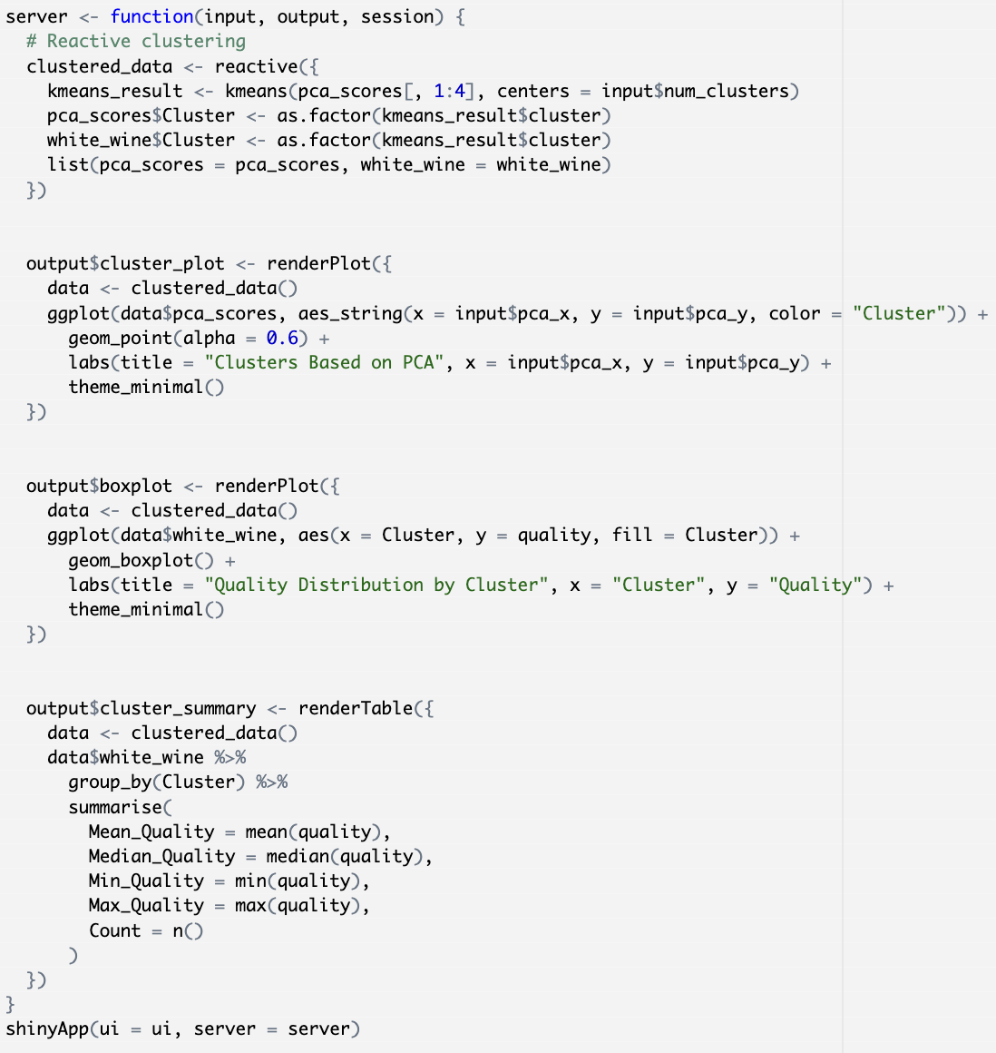
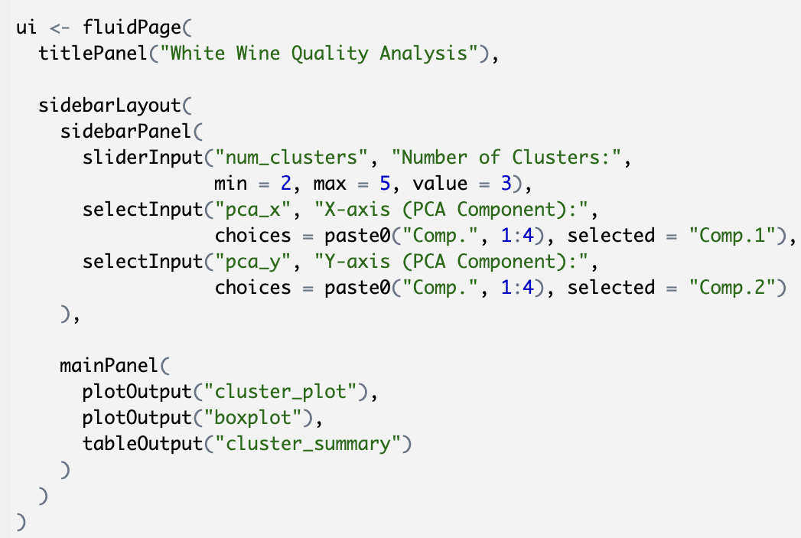
Shiny App
Server-logic:
Users-Interface:
12/20/2024

Slide 11
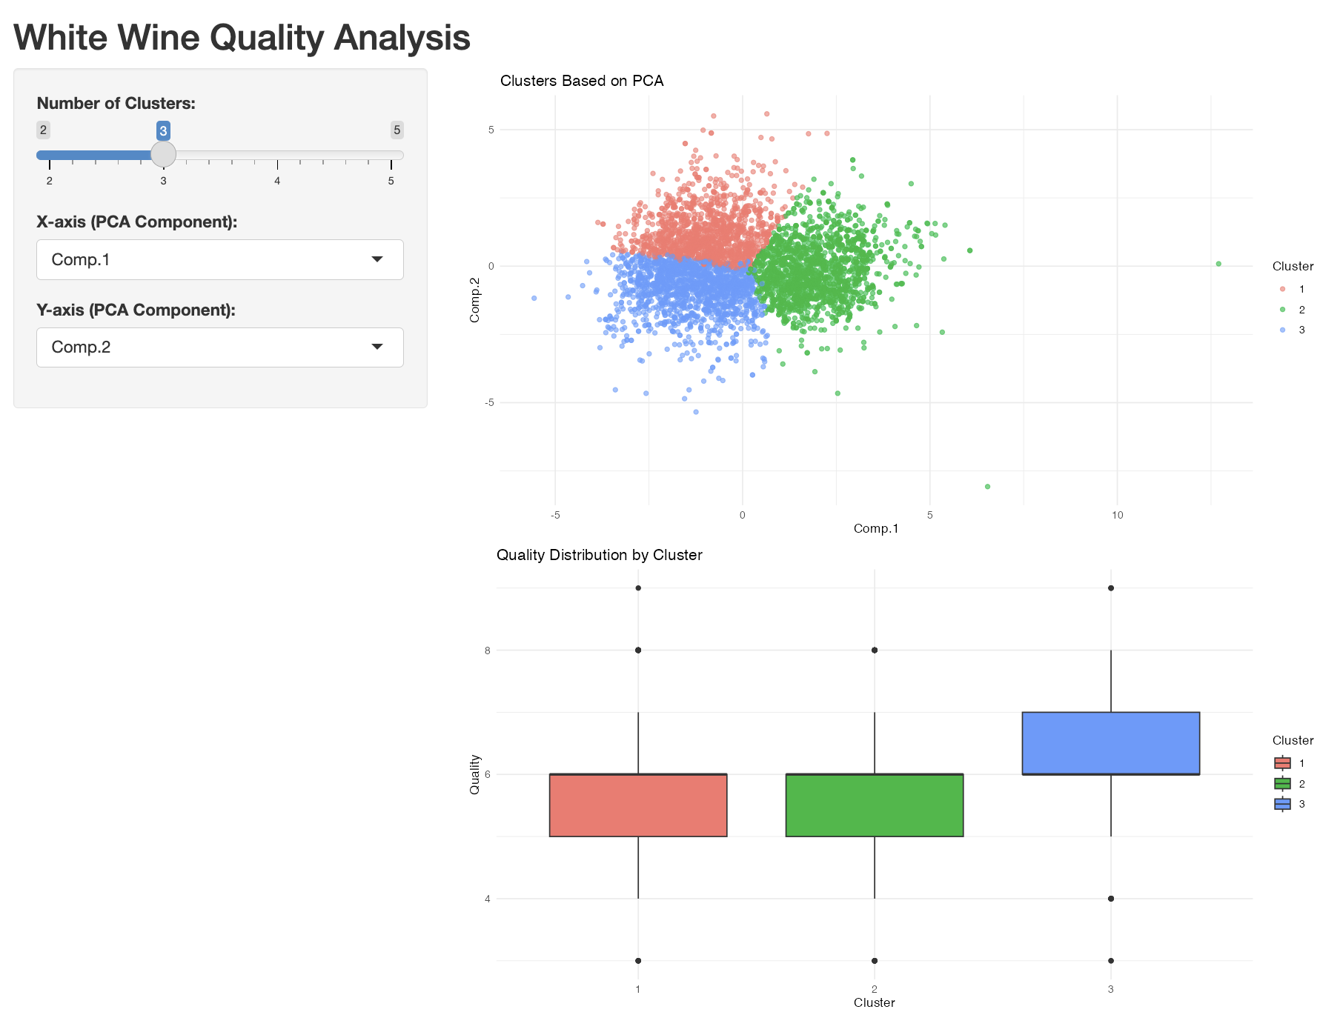

Shiny App

Slide 12
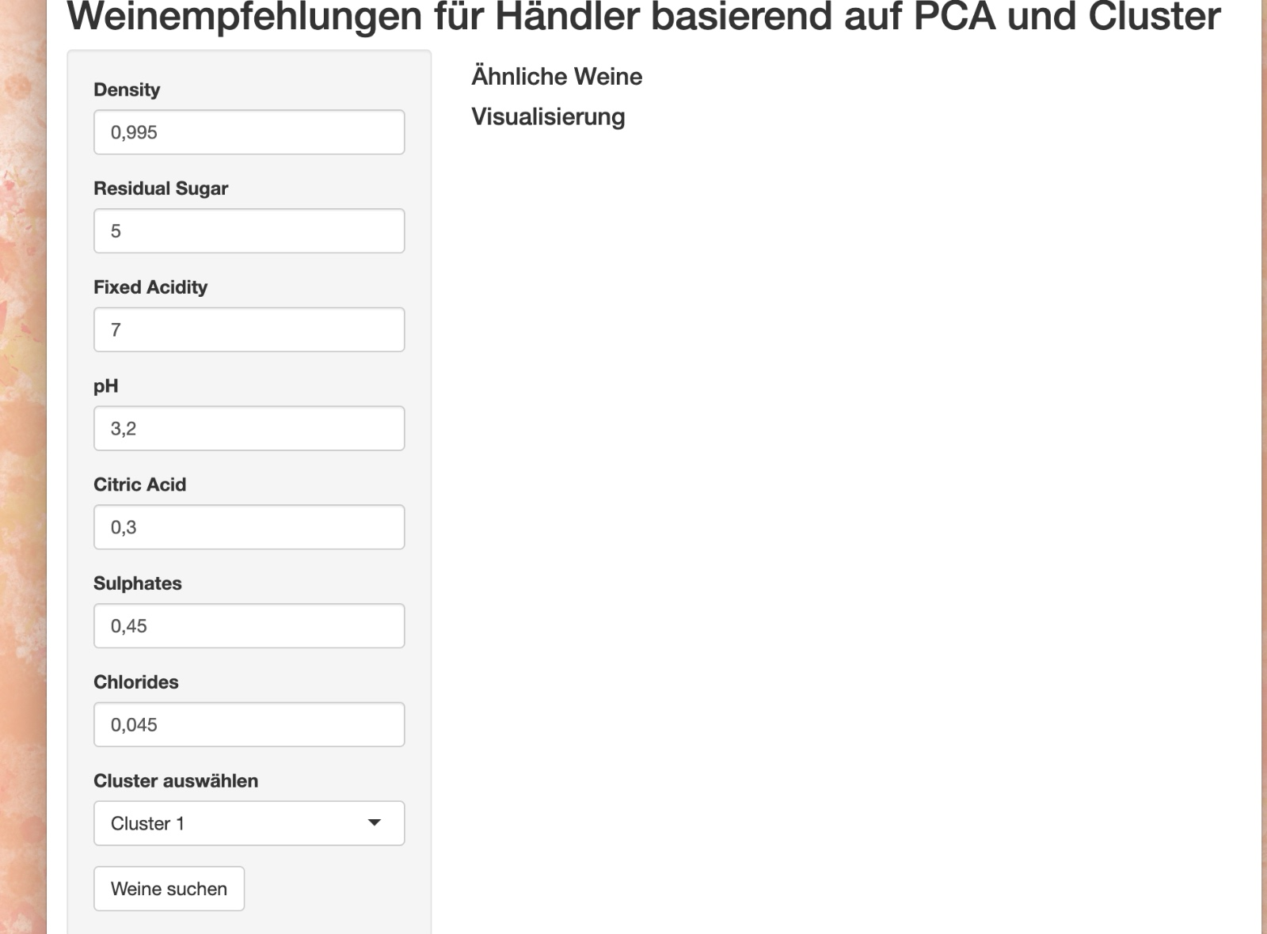
Shiny App

Slide 13
Shiny App
https://gb99.shinyapps.io/shiny/
https://github.com/BioLabGP2/BioLabGP2

Slide 14
References
BKWineMagazine (2022): The countries with the highest wine consumption per person in 2020. https://www.bkwine.com/features/more/wine-consumption-per-person-2020/ (last seen 18.12.2024)
P. Cortez, A. Cerdeira, F. Almeida, T. Matos and J. Reis: Modeling wine preferences by data mining from physicochemical properties. In Decision Support Systems, Elsevier, 47(4):547-553, 2009. https://www.kaggle.com/datasets/piyushagni5/white-wine-quality (last seen 18.12.2024)
statista (2024): Wine consumption per capita in Portugal from 2017/2018 to 2022/2023. https://www.statista.com/statistics/1393947/portugal-wine-consumption-per-capita/#:~:text=Wine%20consumption%20per%20capita%20in%20Portugal%202017%2F2018%2D2022%2F2023&text=In%20Portugal%2C%20wine%20consumption%20generally,consumption%20volume%20totaled%2058%20liters. (last seen 18.12.2024)
statista (2024): Per capita consumption of wine in Germany from 2008 to 2023. https://www.statista.com/statistics/508812/wine-per-capita-consumption-germany/#:~:text=This%20statistic%20depicts%20the%20average,consumed%20per%20capita%20in%202023. (last seen 18.12.2024)

